Slide 1


Bioschemas: Enabling Findability & Interoperability
Alasdair J G Gray Heriot-Watt University/ELIXIR-UK
Bioschemas Community
http://bioschemas.org/people/

Slide 2
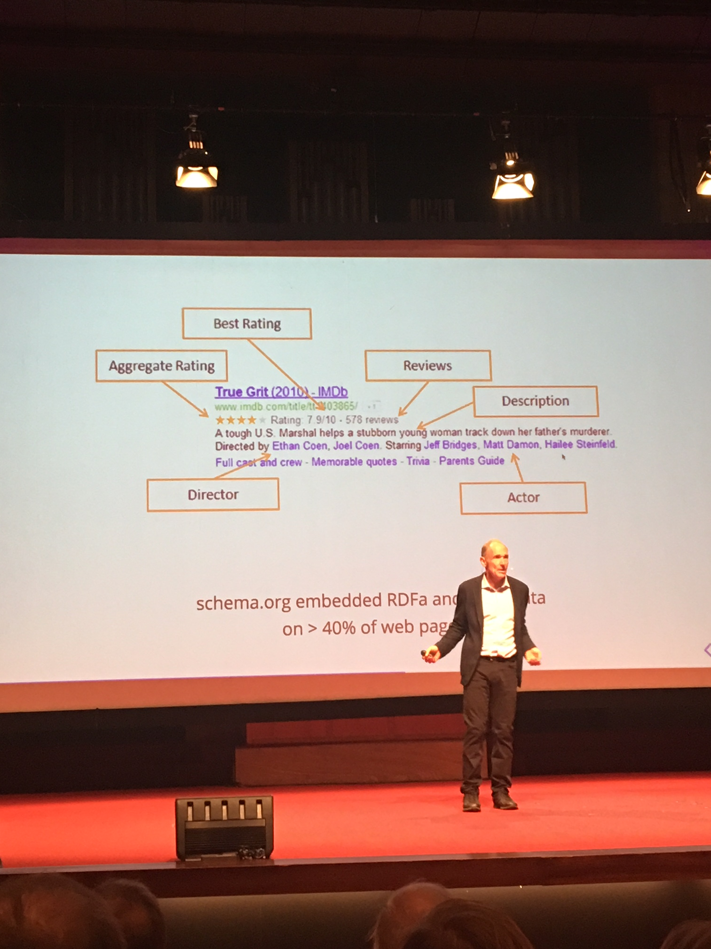
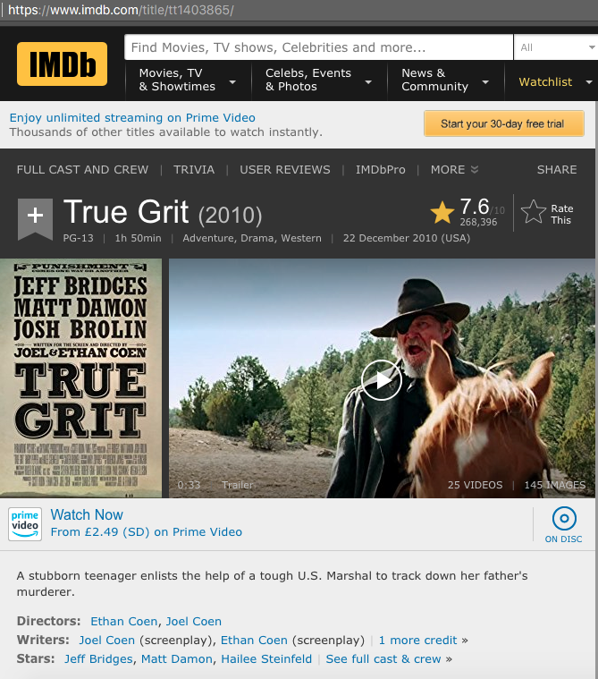
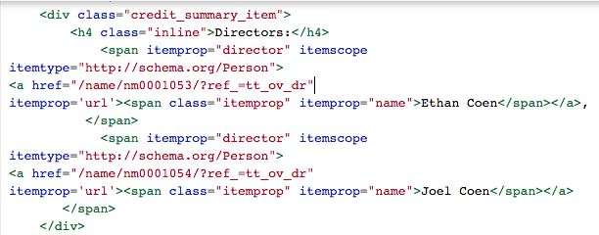
Schema.org: Semantic markup for web pages
Picture: Carole Goble, Turing Lecture 2018
Notes:
IMDb page for True Grit: looks like normal web page
Markup in the page makes it interpretable by machines
Allows content consumers to develop smart apps
T B-L believes this is the Semantic Web
40% of web pages contain markup

Slide 3

Bioschemas
Schema.org for life sciences
Introduce life sciences types
Use case driven
Finding data
Presenting search results
Metadata exchange
Minimum properties – 6
Link to domain ontologies
Profile over schema.org
Layer of constrains + documentation + extensions
Specification
Data model
Minimum information
Controlled vocabularies
Cardinality
New (properties | types)
Documentation
Examples

Slide 4
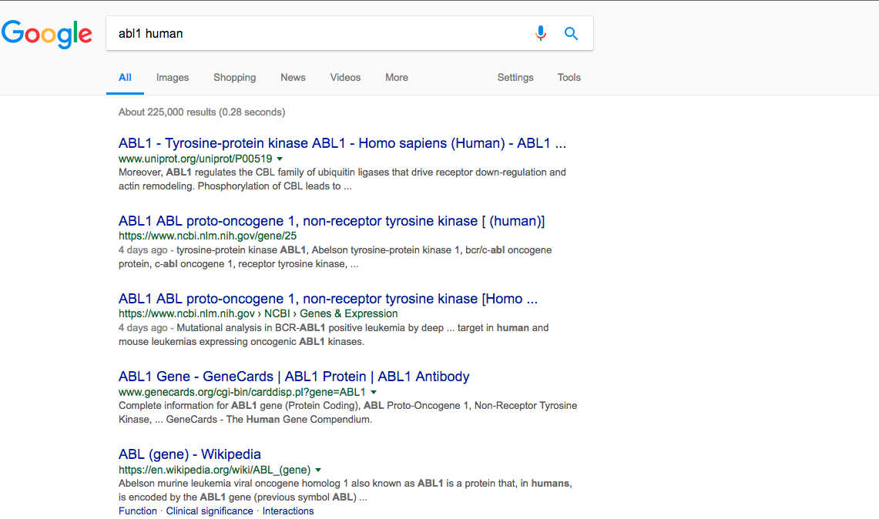
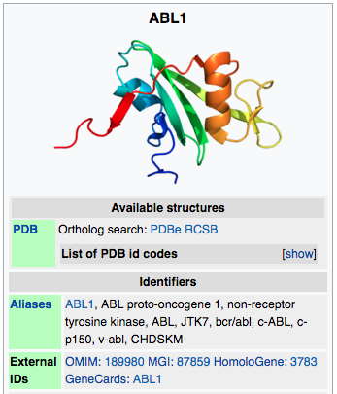
Notes:
Currently no rich search results
Would like something more like this

Slide 5
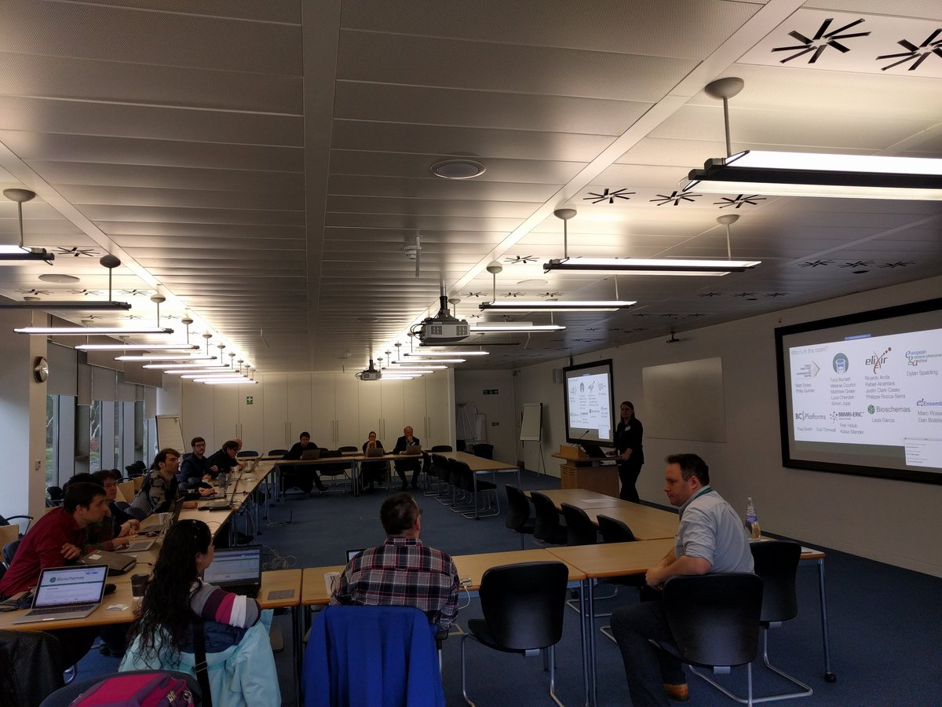
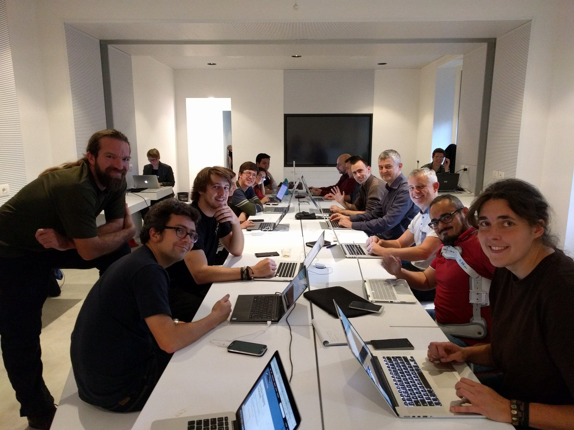
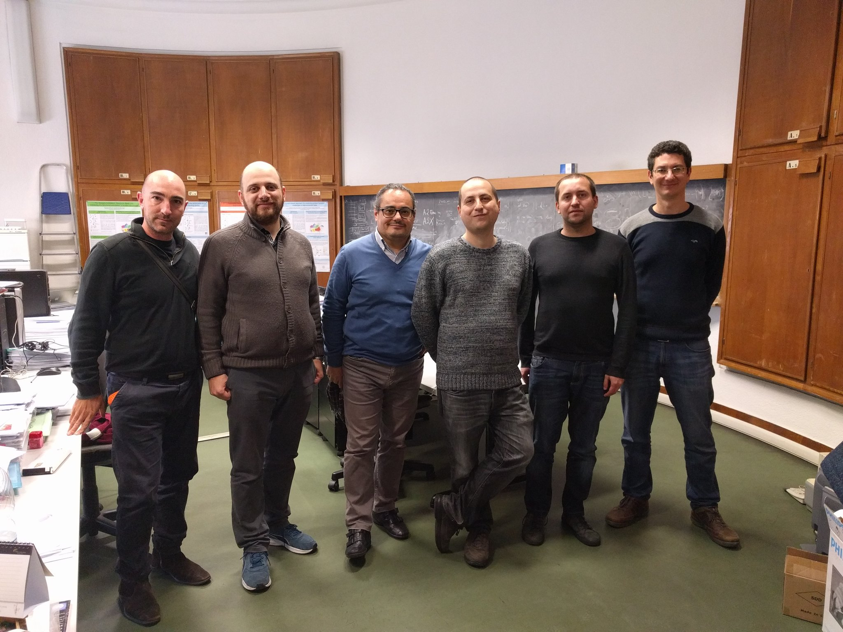
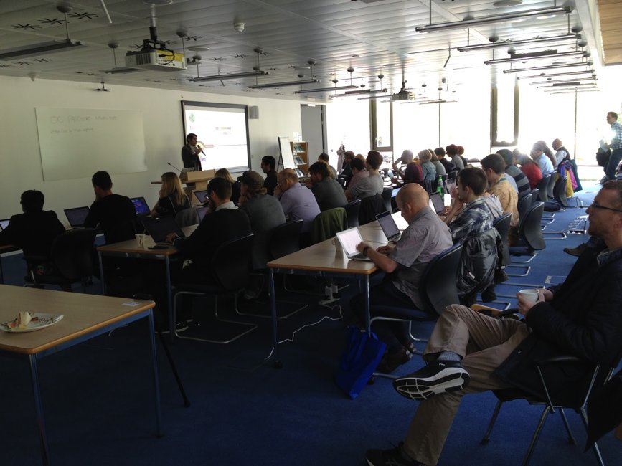
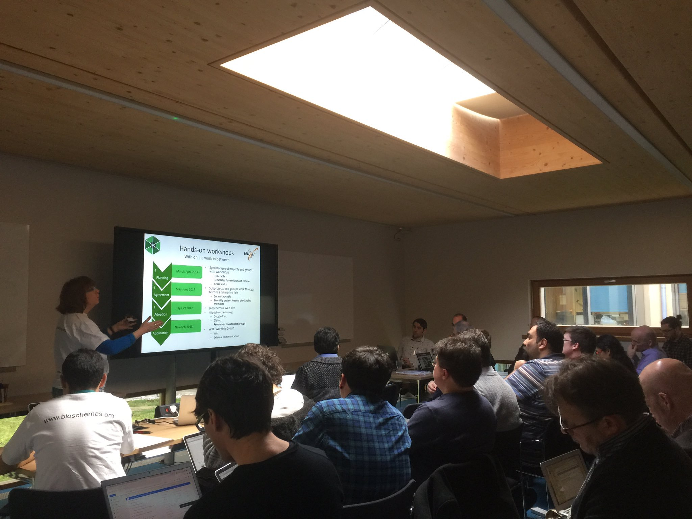
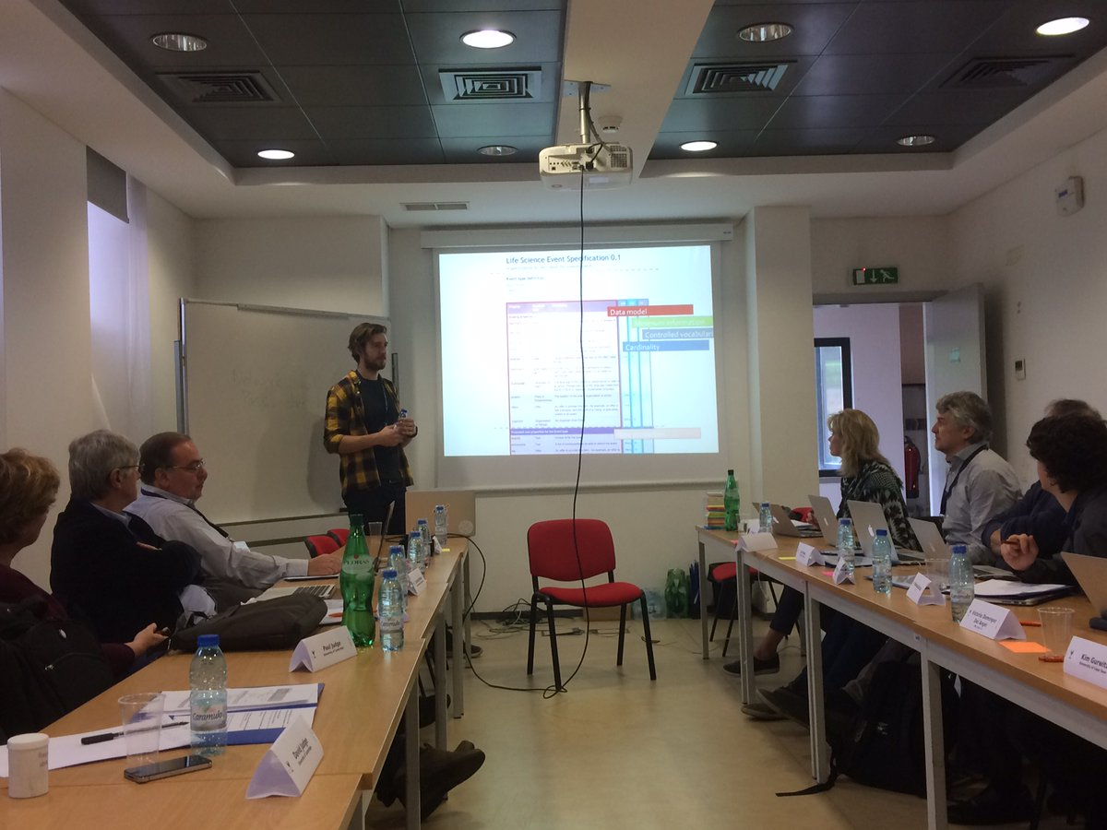
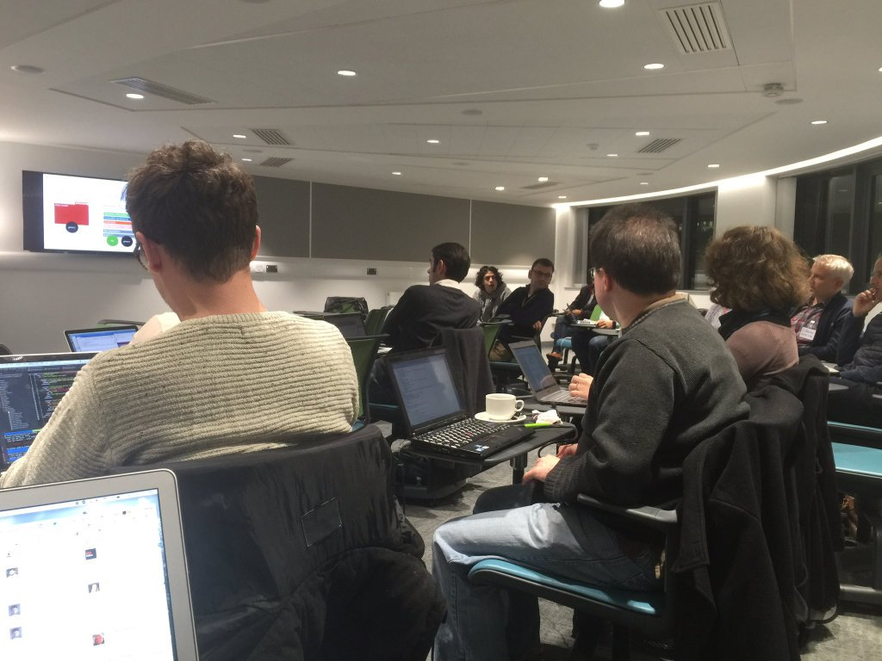
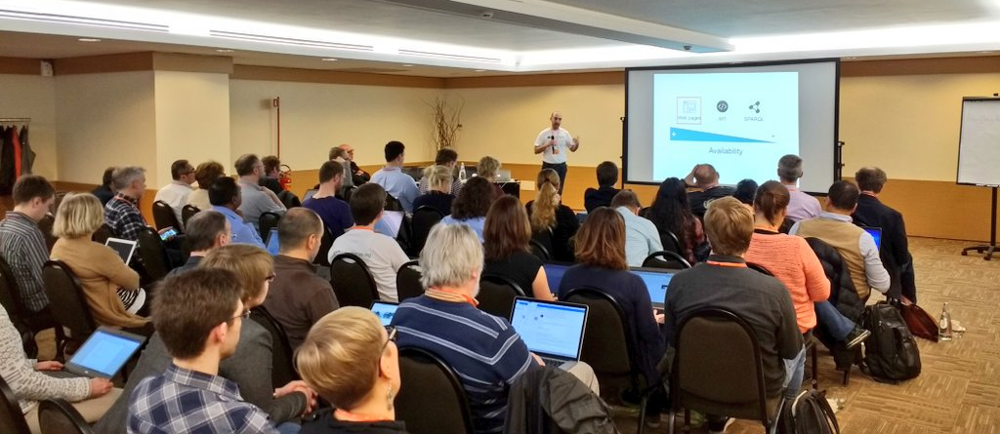
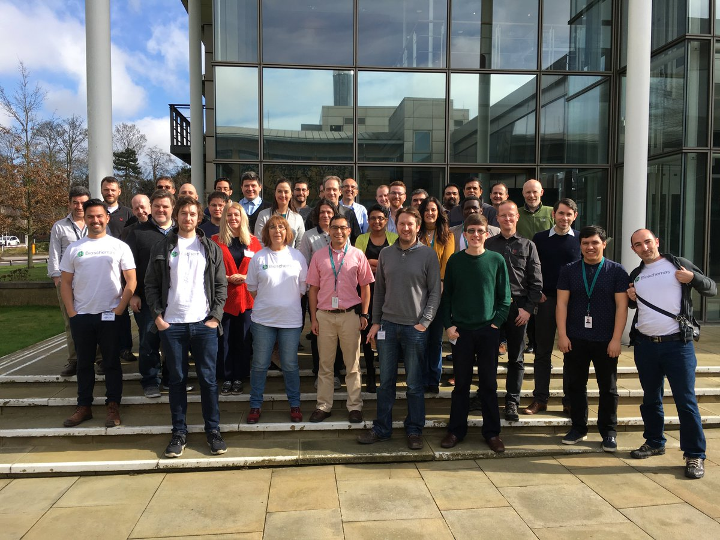
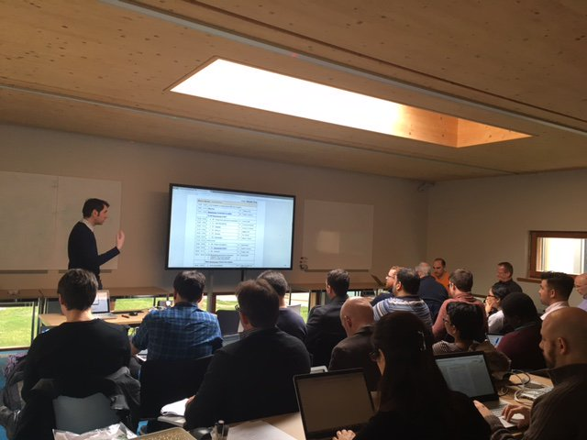
Bioschemas Community
44
15
18
7
Live
deploys
Working groups
Profiles
Types
6M+
200+
35
Pages
PMs
(funding)
People
Notes:
Thriving grassroots community
Over 200 people
18 Events
15 Profiles
30 Live deployments
6 Million+ pages

Slide 6
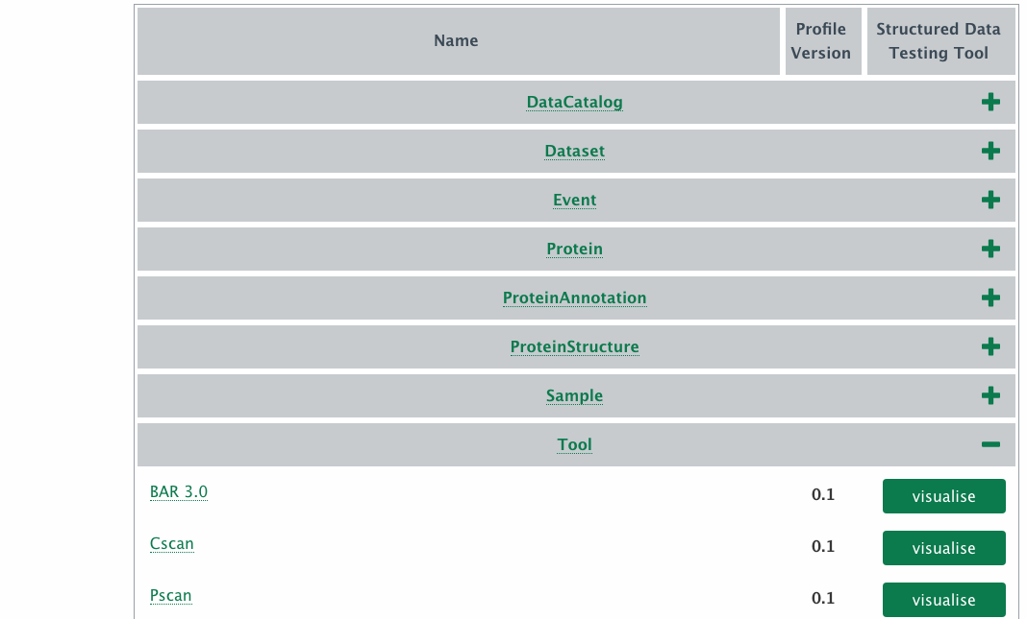
Bioschemas Deployments http://bioschemas.org/liveDeploys/
44
Live
deploys
6M+
Pages

Slide 7
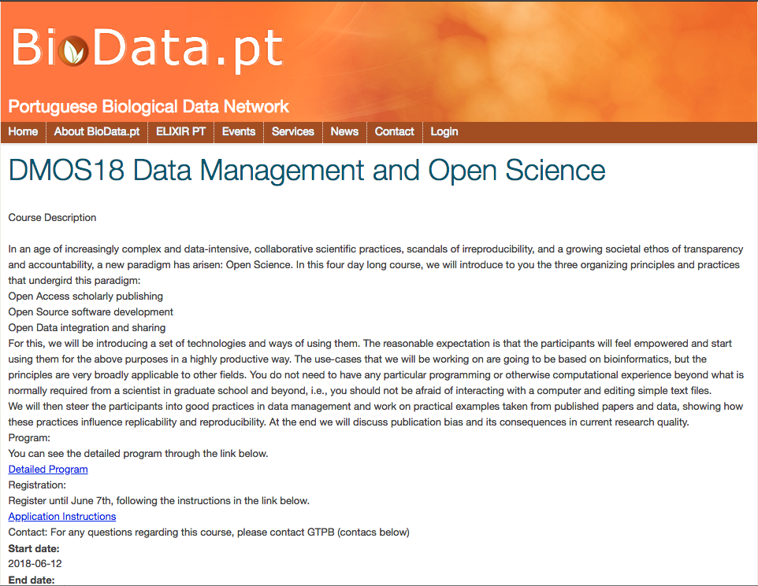
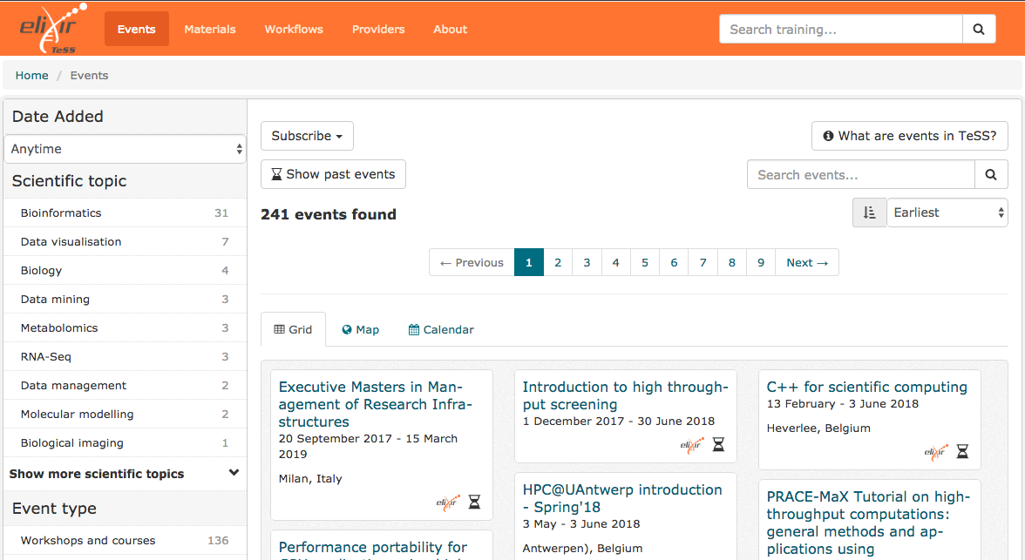
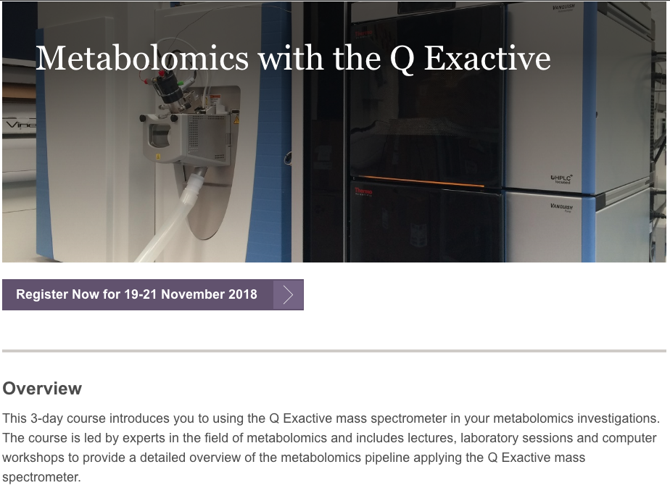
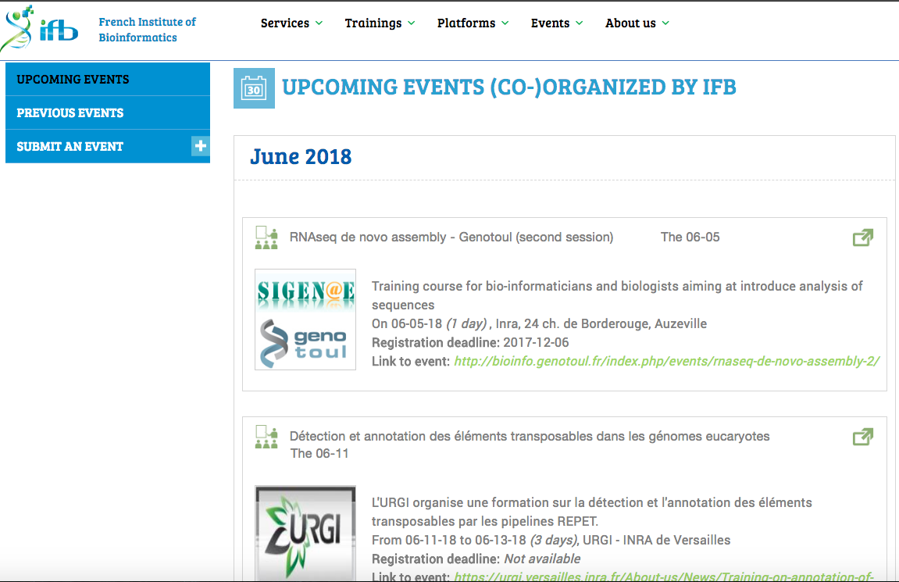
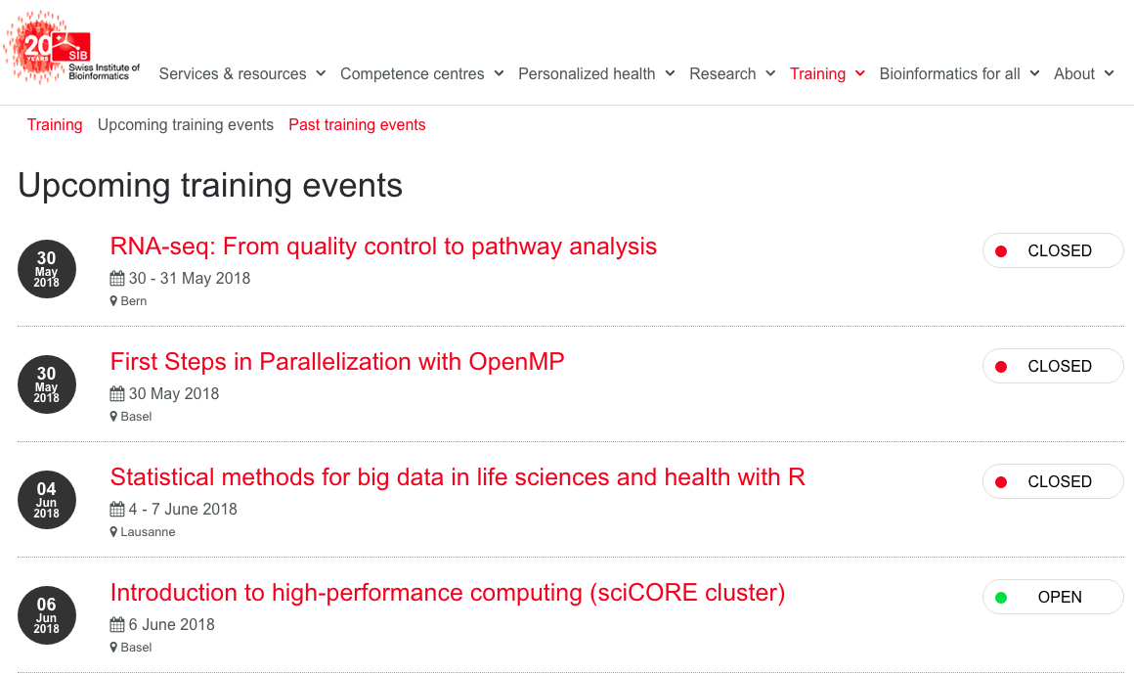
TeSS: Bioschemas in action
Notes:
Similar work in
FAIRsharing
Identifiers.org
Biosamples

Slide 8
Hackathon Tasks
Resource markup
Create new profiles
Develop support tools

Slide 9
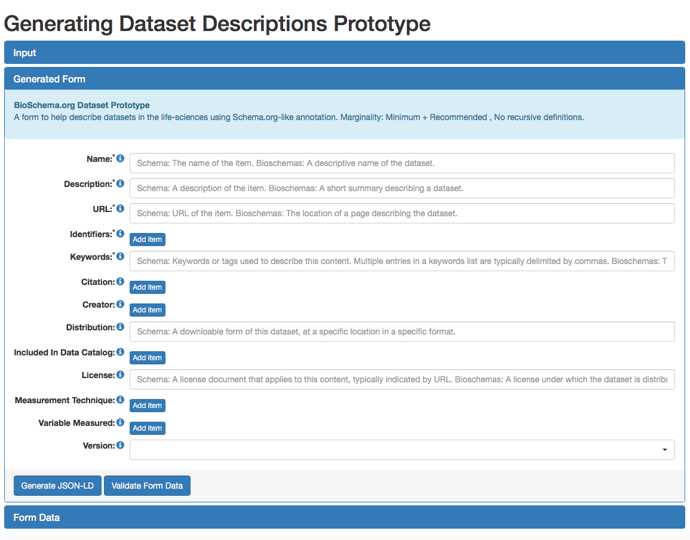
1. Resource Markup http://bioschemas.org/specifications
Tasks:
Generate markup for resources
DataCatalog
Dataset
…
Refine generated markup
Submit example markup to GitHub
Task lead: Alasdair Gray/Phil Barker
http://www.macs.hw.ac.uk/~ajg33/BioschemasGenerator

Slide 10
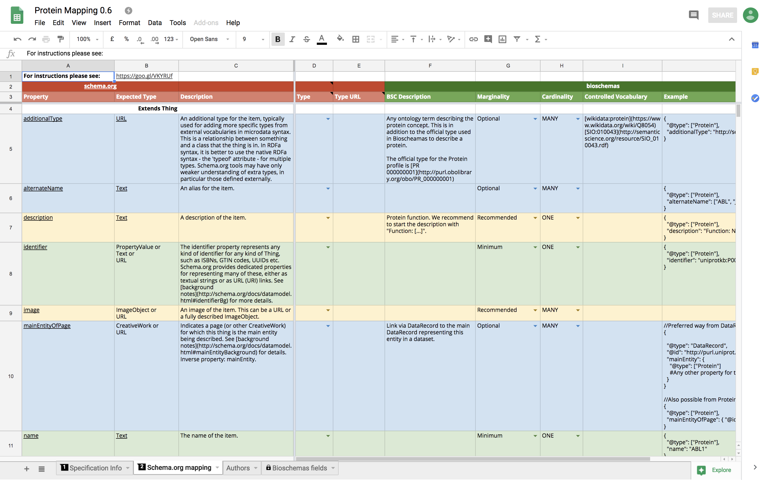
2. Profile Creation/Refinement
Tasks:
Develop missing profiles/types
Chemistry
Metabolites
…
Refine profiles
Complete embedded examples
Provide example markup
Improve documentation
Prepare schema.org submission
Task lead: Alasdair Gray/Phil Barker

Slide 11
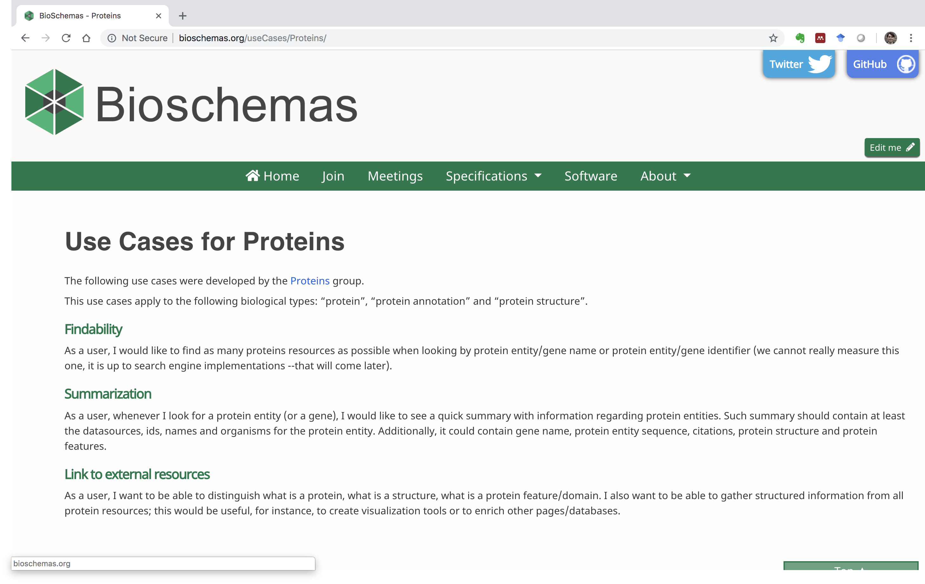
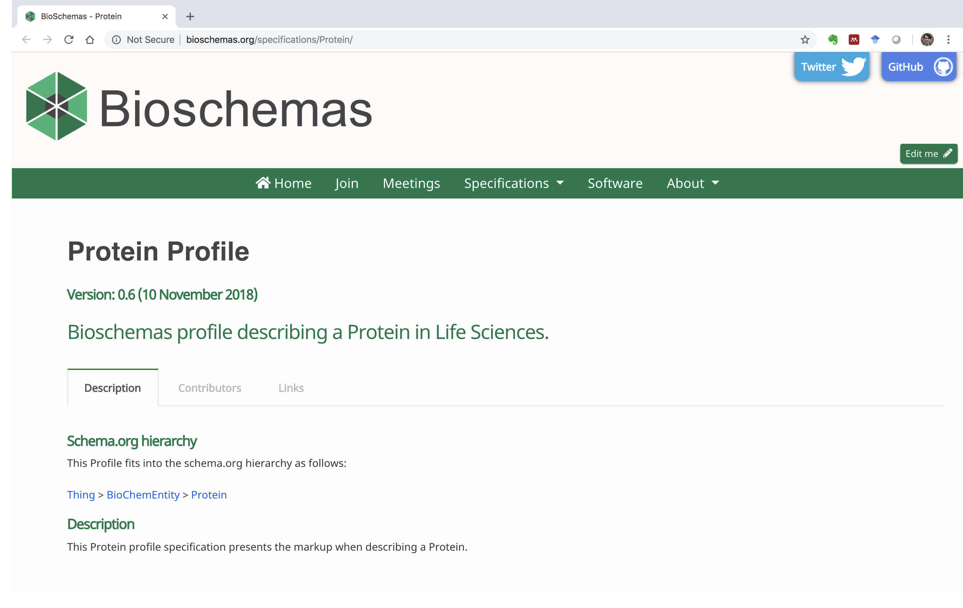
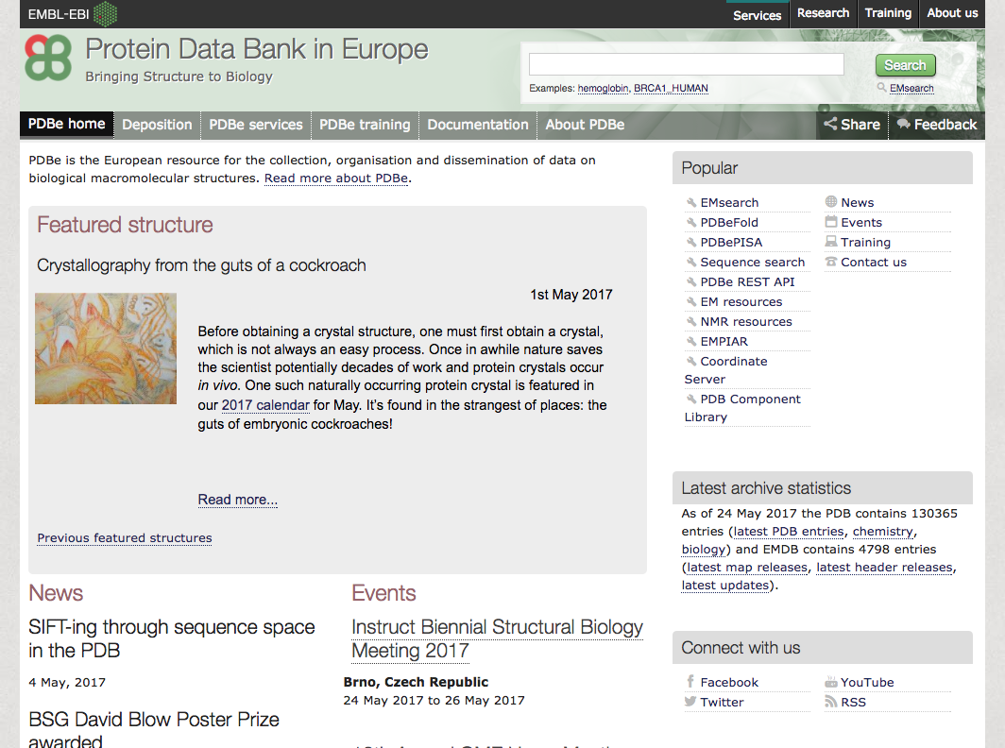
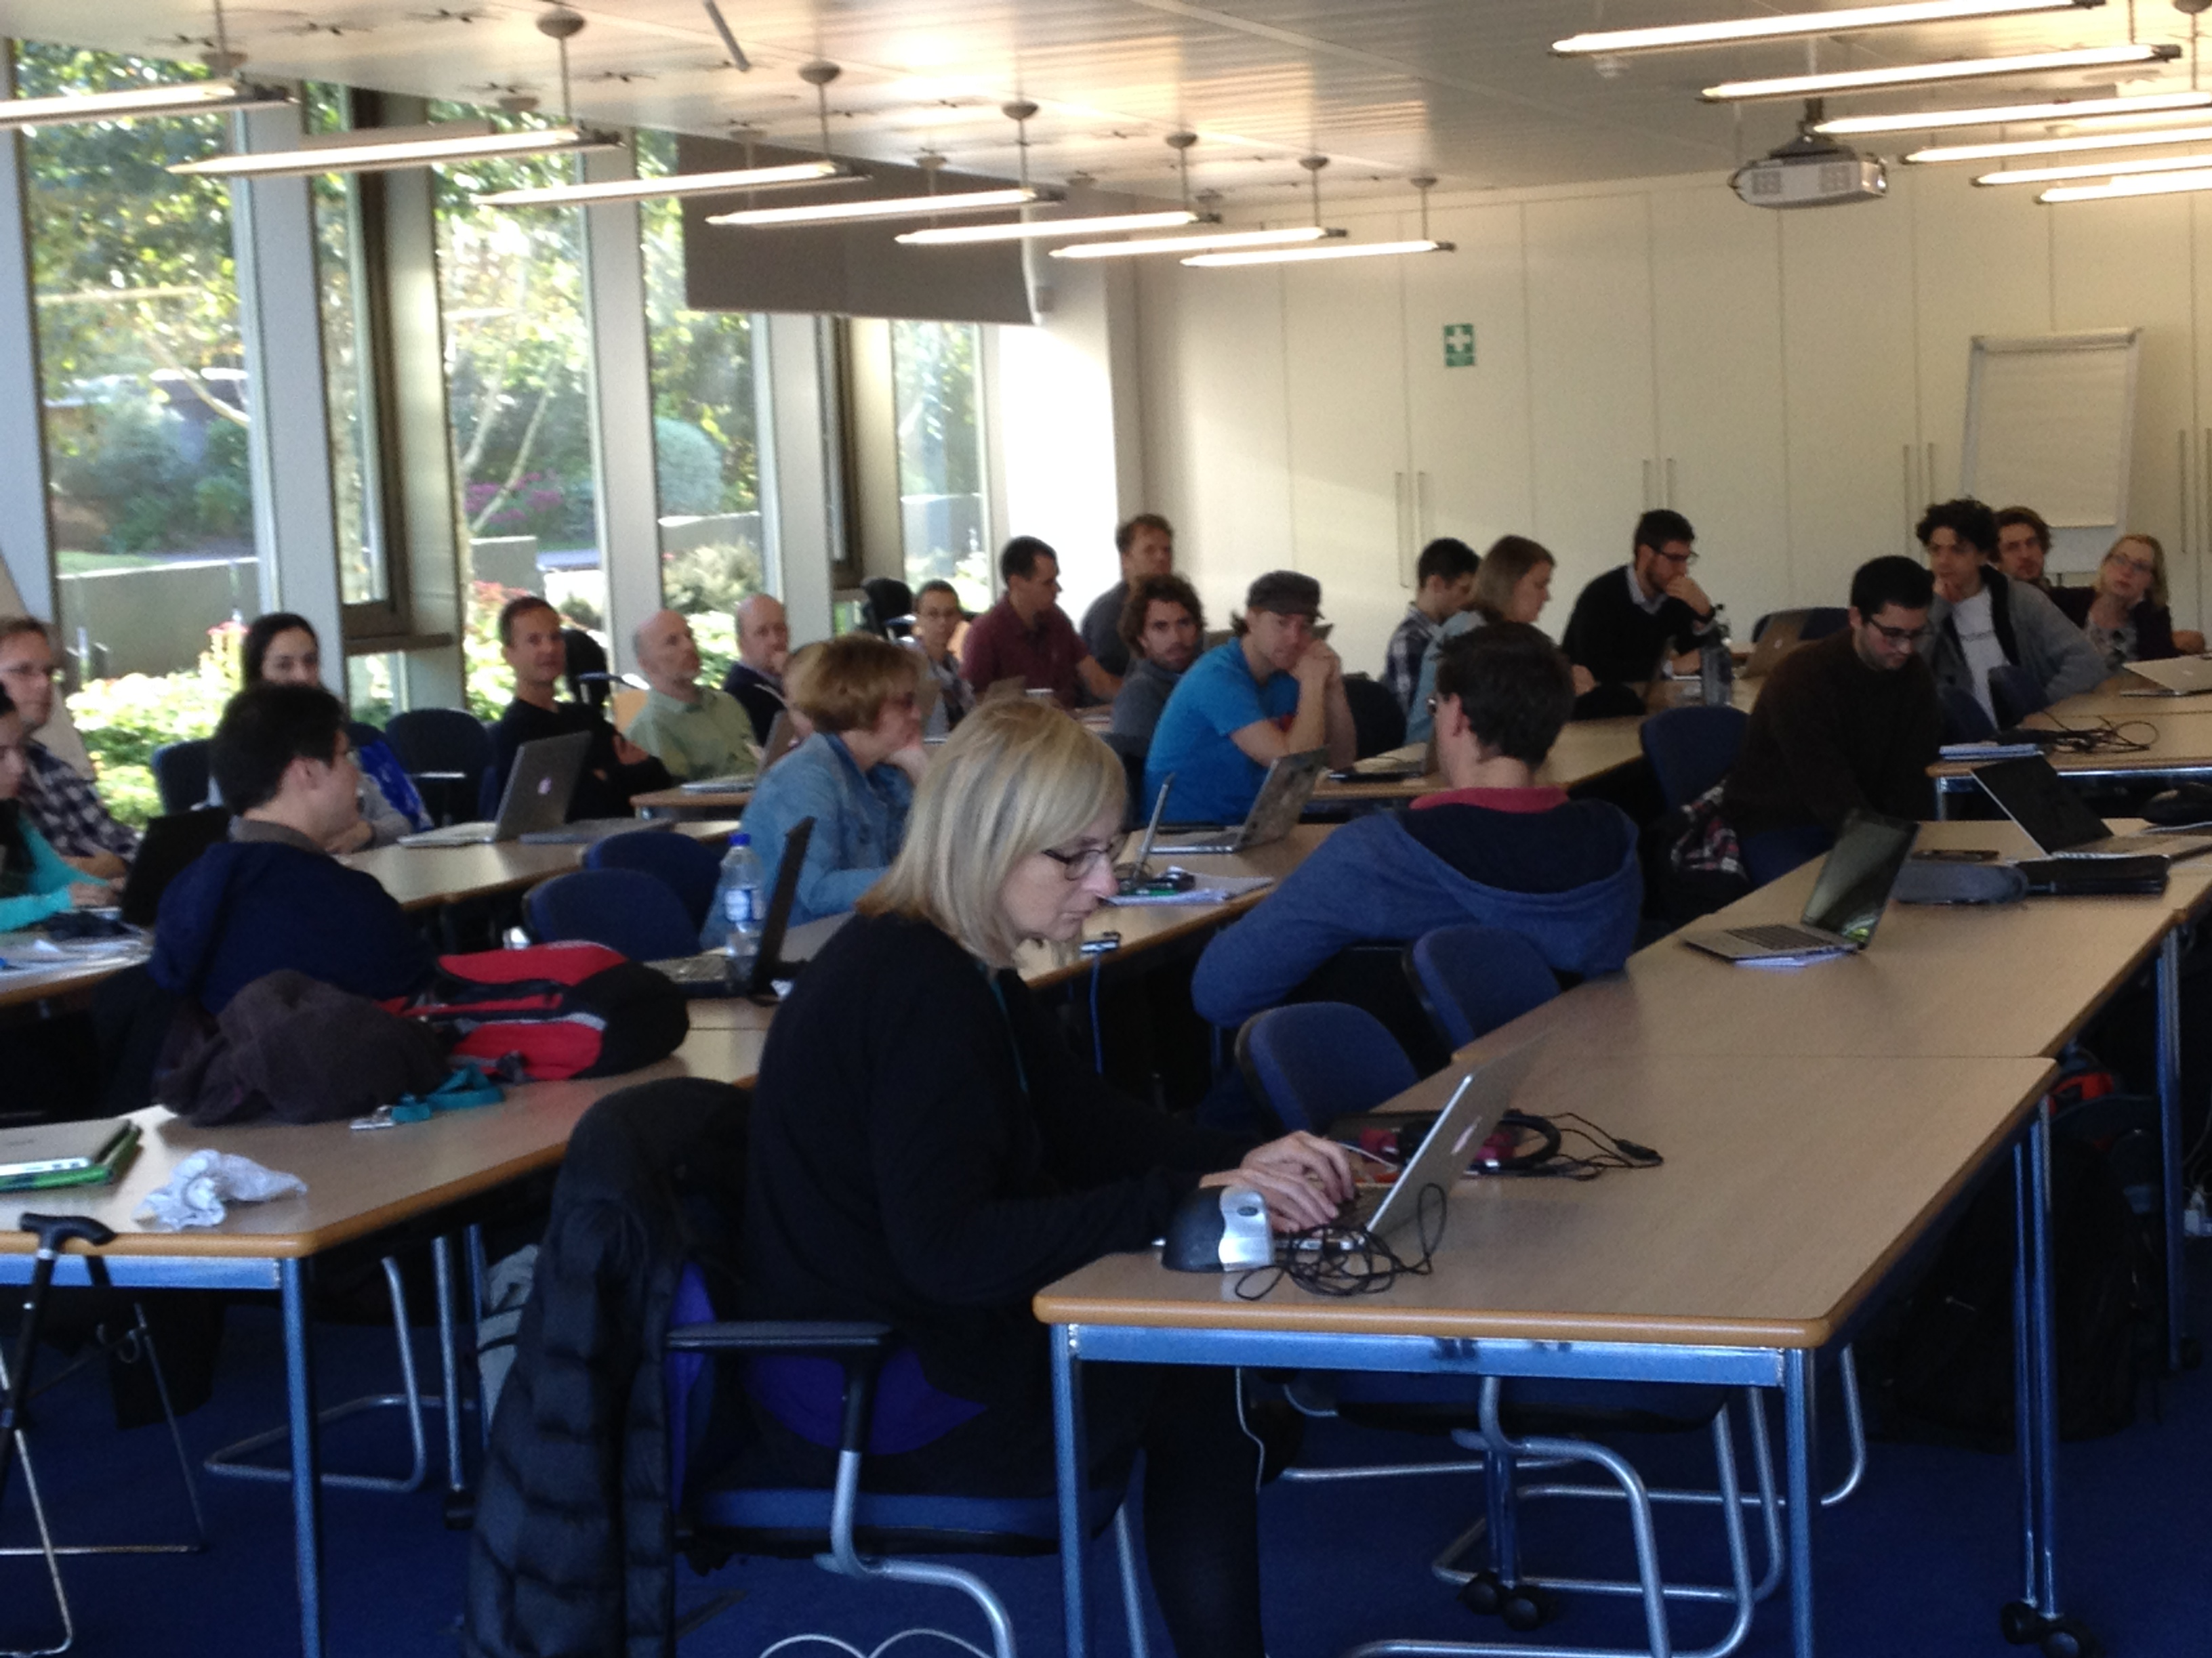

Profile Creation Process
Use cases
Mapping
Profile
Adoption
Mockup
Testing
Application
Notes:
Define use case
Metadata crosswalk and mapping to schema.org
Metadata providers
Metadata registries
Standards defining metadata
Bioschemas specification
Define minimum properties based on “finding” use cases
Define cardinality and suggested controlled vocabularies
Test with existing entries
Adoption by data repositories and registries
Applications

Slide 12
3. Developing Support Tooling

Slide 13
GoWeb: Profile Page Generation https://github.com/BioSchemas/bioschema-goweb
Tasks:
Remove output to stdout
Unless in verbose mode
Generate JSON-Schema/ShEx
Task lead: Ricardo Arcila

Slide 14
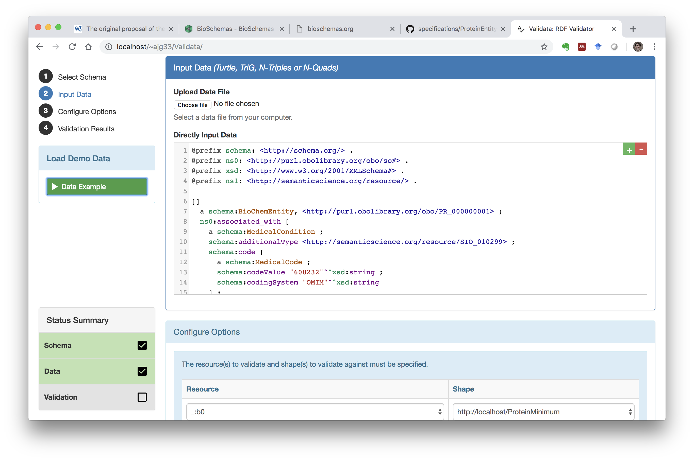
Validata: Markup Validation https://github.com/HW-SWeL/Validata
Validate markup against profiles
Based on Shape Expressions (ShEx)
Tasks:
Debug JSON-LD support
Develop ShEx schemas for profiles
Improve UI
Support ShEx authoring
Task lead: Alasdair Gray

Slide 15
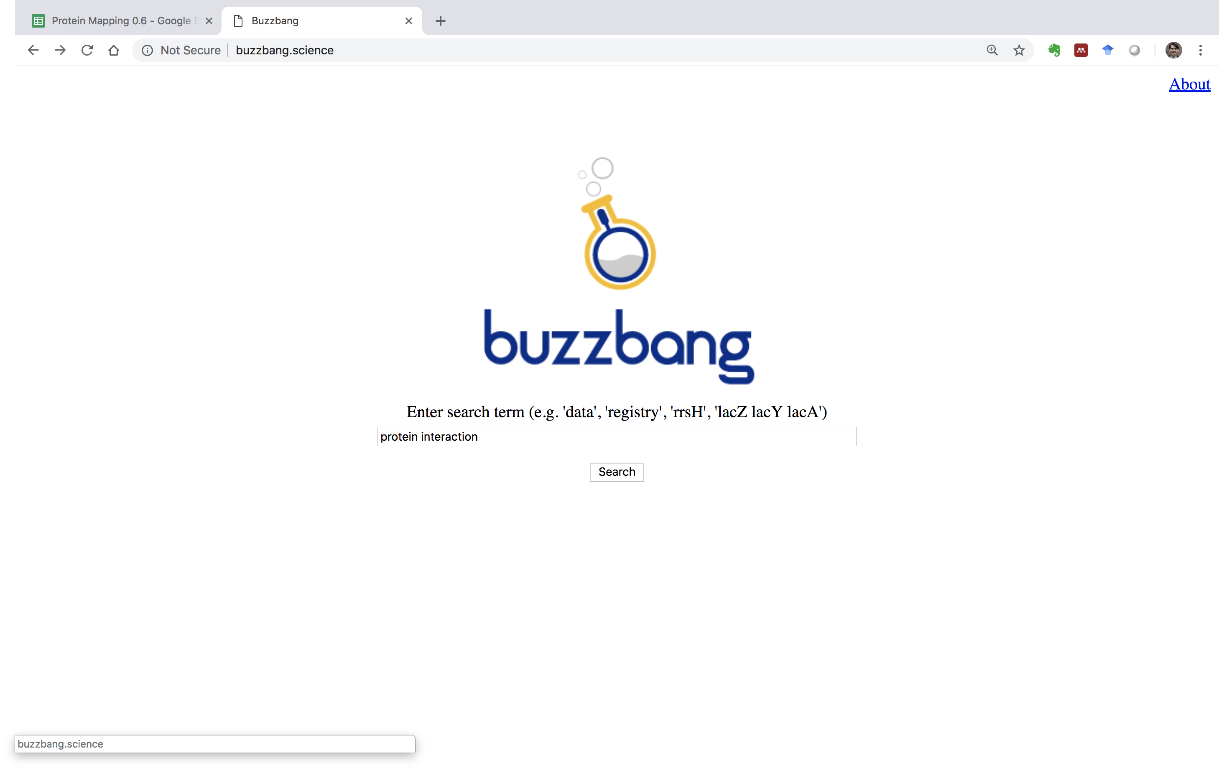
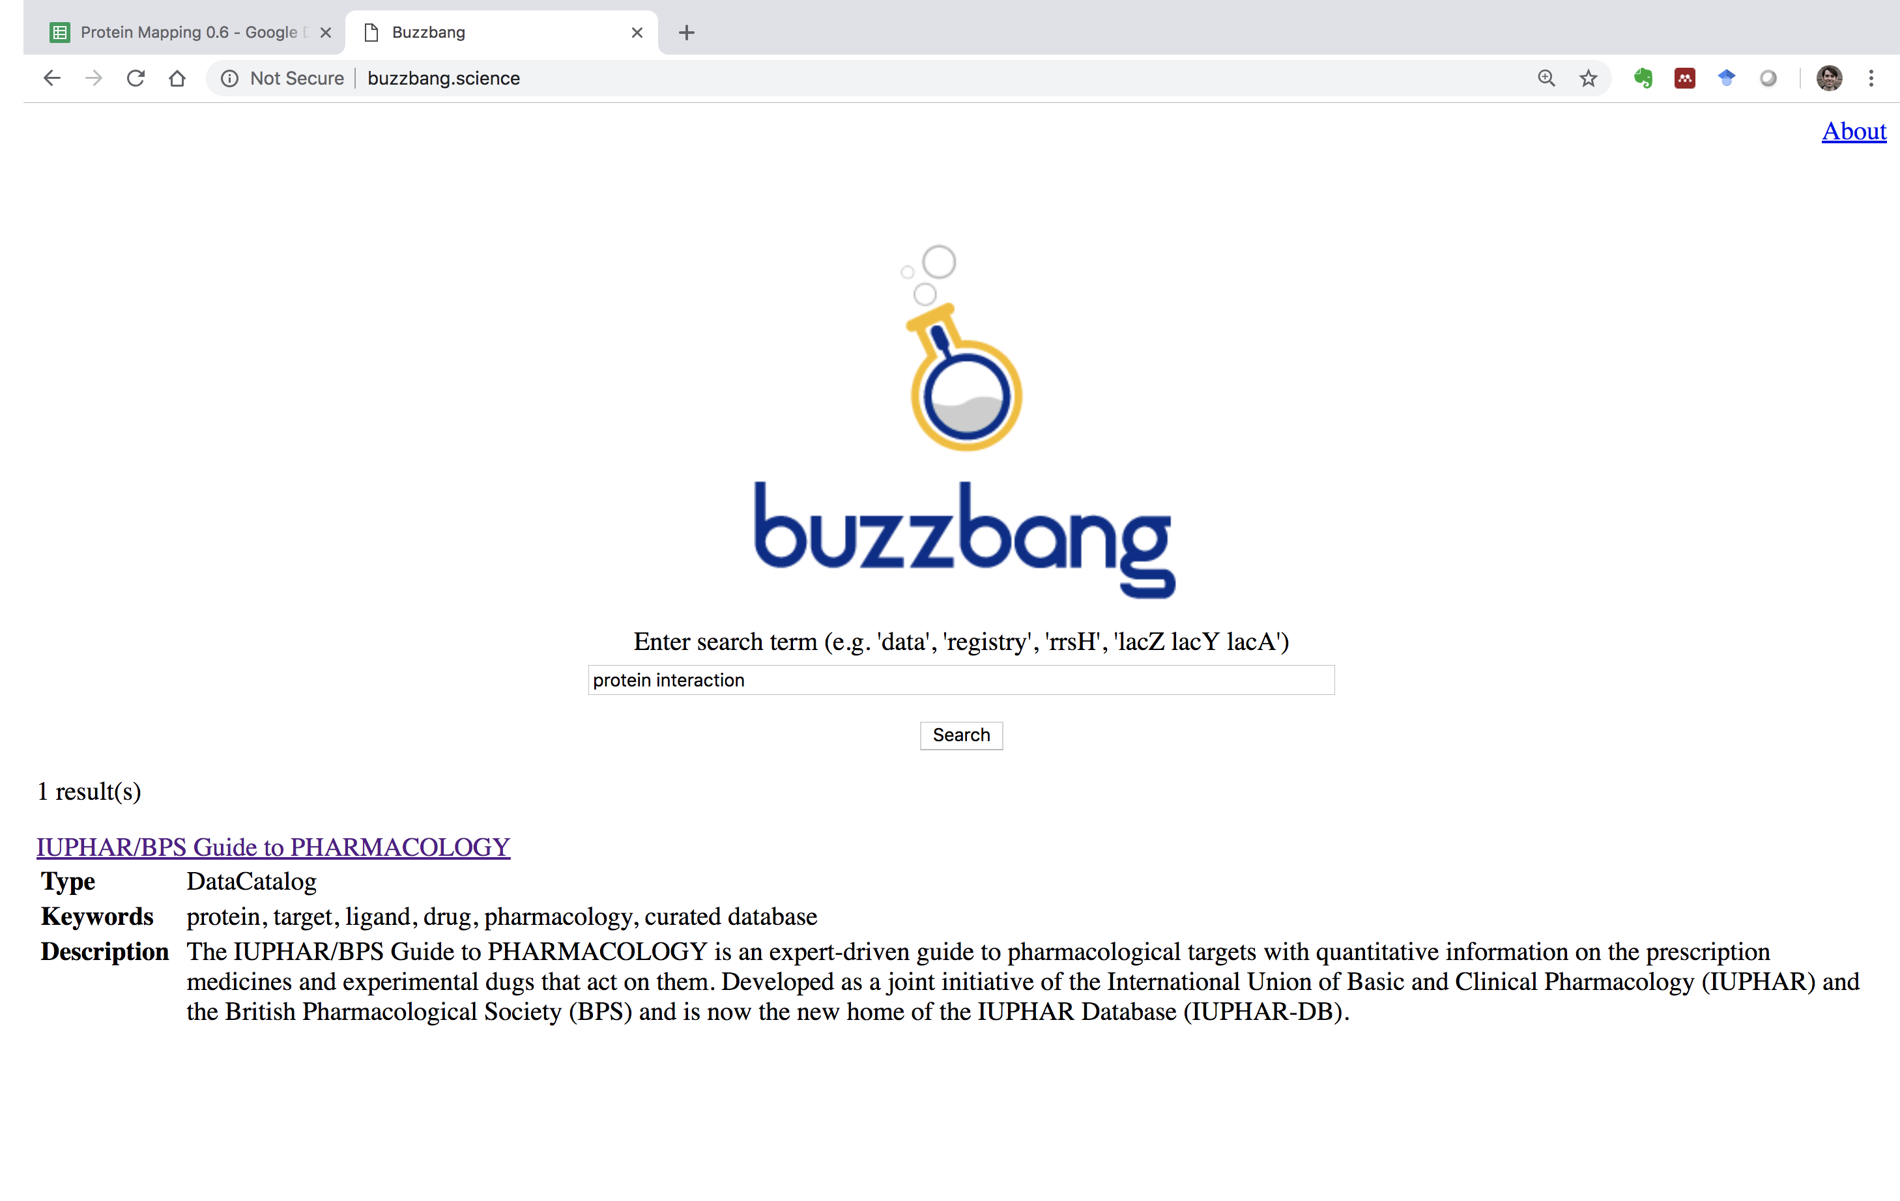
Buzzbang: Enhancing Search https://github.com/buzzbangorg/buzzbang-doc/wiki
Markup crawler
Search interface
Tasks:
Enhance crawler
Improve search UI
Task lead: Alasdair Gray

Slide 16
Open to new ideas
and
collaborations with other hacks

Slide 17
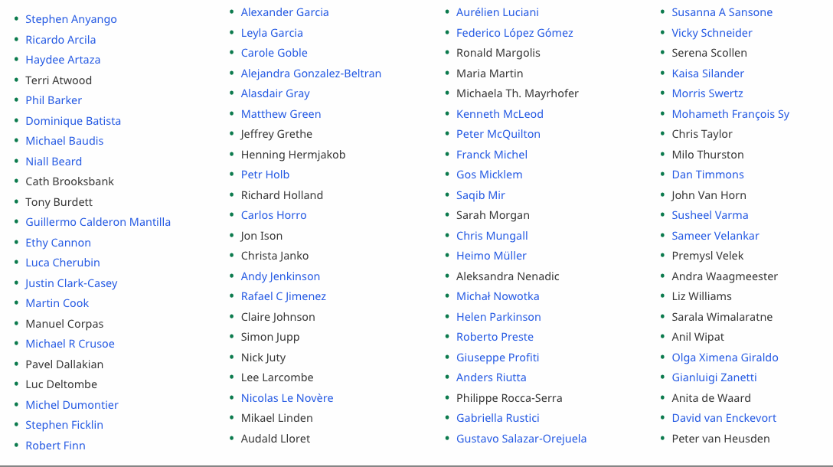
Acknowledgements http://bioschemas.org/people/

